Slide 1

OFFICES OF EMERGENCY MANAGEMENT
How well prepared are OEM to assure accessibility for people with disabilities?
PACIFIC ADA CENTER
WEBINAR
APRIL 11, 2019
Robyn Gershon, MT, MHS, DrPH
Clinical Professor

Slide 2


Acknowledgements
Lewis Kraus, Co-Director Pacific ADA and Co-Investigator on study
Michelle Muska, Research Assistant
Qi Zhi, Project Statistician

Slide 3
Overview of Today’s Webinar
Background Information
  OEM role and responsibilities in disaster preparedness and response
  Review why it is important to know if OEM are prepared to meet their responsibilities under ADA
2018 Survey of FEMA Region 9 OEM
Applying these Findings
Notes:
Review the role of Local Offices of Emergency Management in preparing and responding to disasters in their community that is inclusion of ALL members of the community, including people living with a disability.
Find out how they are doing – where the gaps and challenges are-
The ultimate goal of this research is to Improve Preparedness and Response for People with Disabilities and Access and Functional Needs

Slide 4
Learning Objectives
To determine if local OEMs understand and carry out their responsibilities under the ADA
List the items used to measure OEM preparedness to meet these responsibilities
Discuss strategies for improvement

Slide 5
Underlying Questions
What are the roles and responsibilities of OEM … with respect to ADA?
Why is it important to know if OEMs are ready or not?
What types of information can help us answer this question?
How can information on OEM readiness be helpful?
Notes:
To help guide us today- we have a series of underlying questions we would like to address

Slide 6
Office of Emergency Management
Agency at the local or state level responsible for planning, responding, recovering
They vary in size from very small one person operations to over 200 professionals with diverse backgrounds and areas of expertise, including individuals assigned from other City agencies
Notes:
Office of Emergency Management (OEM) or sometimes called Emergency Management Agency (EMA)
Many OEM or Emergency Management agency- as many have now been rebranded- were formerly the local offices of Civil Preparedness
and Defense
Authorities come from The development of a National Response Framework was mandated by the Homeland Security Act of 2002 and Homeland Security Presidential Directive-5. The plan was completed in January 2005 and revised after Hurricane Katrina. The NRF integrates the National Contingency Plan (NCP) and other national-level contingency plans

Slide 7

Notes:
Watch Command Post- for NYC OEM - staffed 24/7 with a crew that monitors several sources of breaking news- including the 3 local airports, weather, police and fire reports, and many other. Many of the staff for this highly demanding assignment are deployed from EMS, Fire, and Police departments.
But… OEM could also consist of a single person or two- they are also responsible for planning, response and recovery

Slide 8
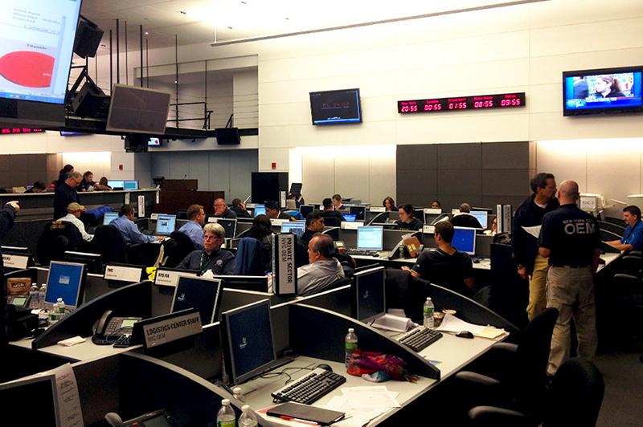
Notes:
Small corner of the main Emergency Operations Center – during 2012 Hurricane Sandy – when it was fully activated

Slide 9
Federal, State, and Local Coordination in Disasters
President
Governor’s Office
Mayor’s
Office
FD
PD
EMS
OEM
Voluntary
FEMA
Emergency Management Office
HHS
CDC
VA, etc.
DOH
DOHMH
Health
Notes:
And just to refresh- all disasters start locally- then as needed, we coordinate at the state and then the federal level

Slide 10
Underlying Questions
What are the roles and responsibilities of OEM … with respect to ADA?
Why is it important to know if OEMs are ready or not?
What types of information can help us answer this question?
How can information on OEM readiness be helpful?
Notes:
So, to move to our first underlying question…

Slide 11
Roles and Responsibilities of Local Emergency Managers
Manage resources before, during, and after a major disaster or emergency
Conduct activities related to key components of emergency management
Coordinate with all partners in the emergency management process
Notes:
https://emilms.fema.gov/IS230c/FEM0104040text.htm
Managing resources before, during, and after a major emergency or disaster.
Taking inventory of personnel and material resources to include the private-sector sources that would be available in an emergency.
Identifying resource deficiencies and working with appropriate officials on measures to resolve them.
Developing and carrying out public awareness and education programs.
Conducting activities related to the key components of emergency management.
Coordinating the planning process and working cooperatively with organizations and government agencies.
Identifying and analyzing the potential impacts of hazards that threaten the jurisdiction.
Conducting threat/hazard and risk assessments.
Coordinating a review of all local emergency- and disaster-related authorities and recommending amendments, when necessary.
Coordinating with all partners in the emergency management process, to ensure they:
Are aware of potential threats to the community, including establishing a system to alert officials and the public in an emergency or disaster.
Participate in mitigation and prevention activities.
Plan for emergencies and disasters using an all-hazards approach, including establishing and maintaining networks of expert advisors and damage assessors for all hazards.
Operate effectively in emergency situations.
Conduct effective recovery operations after a disaster.
Are advised and informed about emergency management activities.

Slide 12

Includes the Authorities of OEM
National Response
Framework
Third Edition
June 2016
Notes:
The authority to have these responsibilities comes from The National Response Framework- it is the guide for the US responds to all types disasters- it is scalable, flexible, and adaptable- and builds upon the National Incident Management Systems or NIMS.
It includes emergency management authorities, as well as both policies and procedures at all local, state, federal levels, plus voluntary private sector organizations.
Also, here and elsewhere in govt documents concept of whole community- that is- that everyone has a responsibility for preparedness- including the general public. FEMA now urges people to be prepared before help arrives for 72hrs, for healthcare facilities this is now 96 hrs

Slide 13
Responsibilities under Title II of the ADA
Under Title II of the ADA, emergency programs, services, activities, and facilities must be accessible to people with disabilities
This requirement applies to programs, services, and activities provided directly by state and local governments as well as those provided through third parties, such as the American Red Cross, private nonprofit organizations, and religious entities.
Notes:
https://www.ada.gov/pcatoolkit/chap7emergencymgmt.htm
One of the primary responsibilities of state and local governments is to protect residents and visitors from harm, including assistance in preparing for, responding to, and recovering from emergencies and disasters. State and local governments must comply with Title II of the ADA in the emergency- and disaster-related programs, services, and activities they provide.1 This requirement applies to programs, services, and activities provided directly by state and local governments as well as those provided through third parties, such as the American Red Cross, private nonprofit organizations, and religious entities.2 Under Title II of the ADA, emergency programs, services, activities, and facilities must be accessible to people with disabilities 3 and generally may not use eligibility criteria that screen out or tend to screen out people with disabilities.4 The ADA also requires making reasonable modifications to policies, practices, and procedures when necessary to avoid discrimination against a person with a disability5 and taking the steps necessary to ensure effective communication with people with disabilities.6 The ADA generally does not require state or local emergency management programs to take actions that would fundamentally alter the nature of a program, service, or activity or impose undue financial and administrative burdens.7

Slide 14
More Responsibilities under Title II of the ADA
Generally they may not use eligibility criteria that screen out people with disabilities
The ADA also requires making reasonable modifications to policies, practices, and procedures when necessary to avoid discrimination against a person with a disability
Take steps necessary to ensure effective communication with people with disabilities.
Notes:
Preparation
 Notification
 Evacuation and transportation
 Sheltering
 Recovery
 Decontamination processes
 Points of Distribution (POD) areas

Slide 15
In Emergency Management, people with disabilities are considered to have access and functional needs
 Here are the inclusion criteria for access and functional needs:
  Physical, developmental or intellectual disabilities (including visual impairments, deaf or hard of hearing, mental health conditions, physical disabilities, cognitive disabilities)
  Chronic conditions or injuries
  Limited English proficiency
  Older adults
  Children
  Low income, homeless and/or transportation disadvantaged
  Pregnant women
Notes:
LK

Slide 16
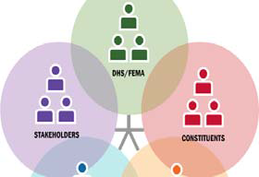
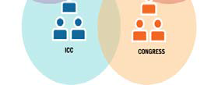
FEMA Office of Disability Integration and Coordination (ODIC)
Established in 2010
Mission Statement
In accordance with Federal civil rights laws and regulations, provide guidance, tools, methods and strategies to integrate and coordinate emergency management inclusive of individuals with access and functional needs.
Notes:
In 2010, FEMA establishes the Office of Disability Integration and Coordination. It has a mission to integrate and coordinate emergency management inclusive of individuals with access and functional needs.

Slide 17
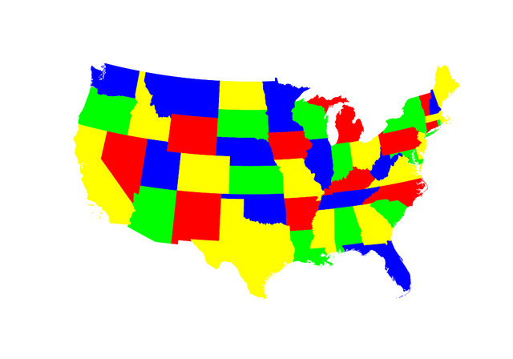
FEMA Regional Disability Integration Specialists
Work in the ten federal regions across the U.S.
Responsible for ensuring that the access and functional needs and requirements of individuals with disabilities are being properly included and addressed in all aspects of emergency preparedness and disaster response, recovery, and mitigation.
Notes:
FEMA’s ODIC establishes a regional system of integration specialists (RDIS) who are responsible for ensuring equal access-

Slide 18
FEMA 2018-2022 Strategic Plan
STRATEGIC GOAL 1:
Building a Culture of Preparedness
STRATEGIC GOAL 2:
Ready the Nation for Catastrophic Disasters
STRATEGIC GOAL 3:
Reduce the Complexity of FEMA
Notes:
Key objective of the FEMA 2018-2020 Strategic Plan- is to ensure that everyone works together--- and further FEMA States: “everyone should be prepared when disaster strikes”.
FEMA advises that people should be prepared to be on their own for at least 72 hrs- for hospitals- 96 hrs
https://www.fema.gov/media-library-data/1533052524696-b5137201a4614ade5e0129ef01cbf661/strat_plan.pdf

Slide 19
Underlying Questions
What are the roles and responsibilities of OEM … with respect to ADA?
Why is it important to know if OEMs are ready or not?
What types of information can help us answer this question?
How can information on OEM readiness be helpful?
Notes:
It seems that we have the underlying authorities- the rules and regulations in place, and the expertise of the Disability specialists to advise…
The question remains, however, as to the preparedness of the OEM to ensure compliance with these rules and regulations
And, this is important to know for a number of reasons

Slide 20
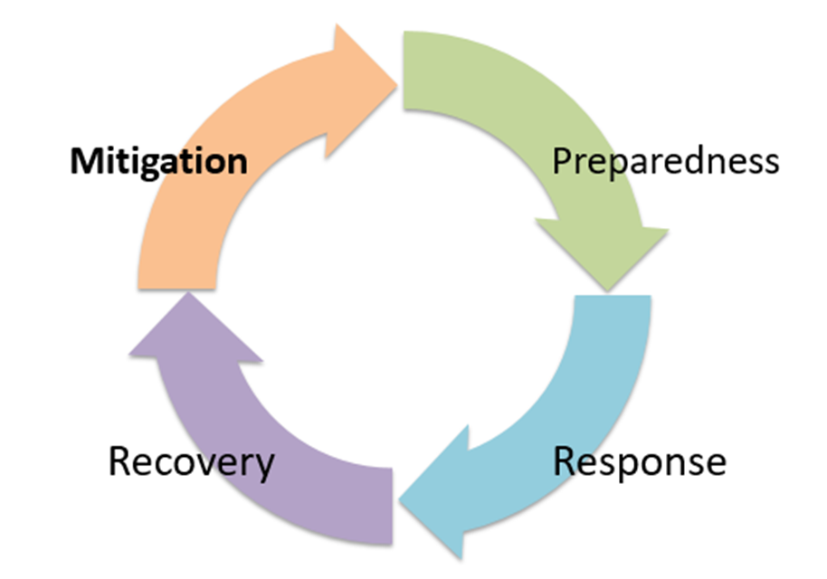
Morbidity, Mortality, and Cost
Notes:
Its important to know…
In general- we need to know if OEMS are ready …in general
OEMs play a critical role in our modern day paradigm of disaster management-while it is more efficient and effective to mitigate potential disaster threats
--- we generally rely on both mitigation and preparedness efforts to reduce morbidity, mortality and cost.
And importantly we know that PREPAREDENESS LEADS TO BETTER RESPONSE AND QUICKER RECOVERY and SUPPORTS RESILIENCY of the COMMUNITY

Slide 21
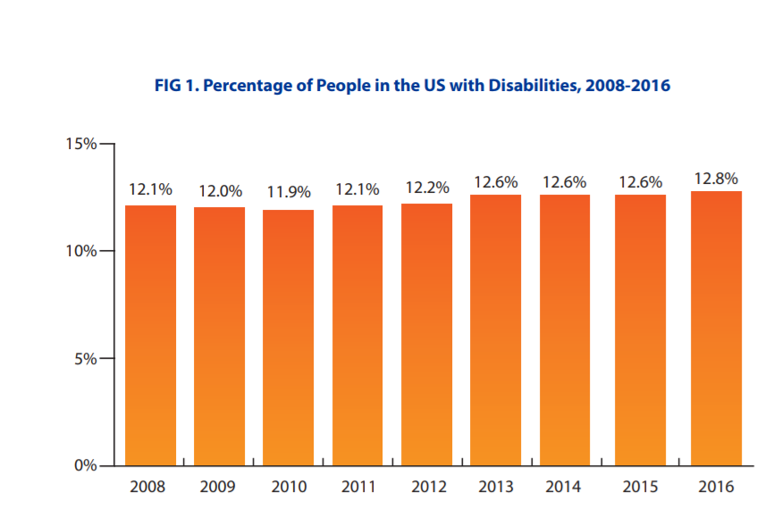
Population of People Living with a Disability is large… and growing
Notes:
Also important to know….
Depending on the source of the data- there are an estimated 55-60M Americans living with a disability.

Slide 22
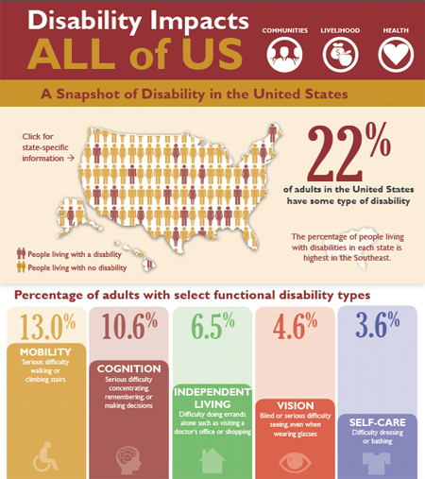
Notes:
The graphic is from CDC: https://www.cdc.gov/media/releases/2015/p0730-US-disability.html
Roughly one in 4 or 5
In 2016 CDC Published a report that was based on the 2016 Behavioral Risk Factor Surveillance System (BRFSS) data. They found that one in four noninstitutionalized U.S. adults (25.7%, representing an estimated 61.4 million persons) reported any disability.
https://www.cdc.gov/mmwr/volumes/67/wr/mm6732a3.htm?s_cid=mm6732a3_w&c_cid=journal_search_promotion_2018#F1_down

Slide 23
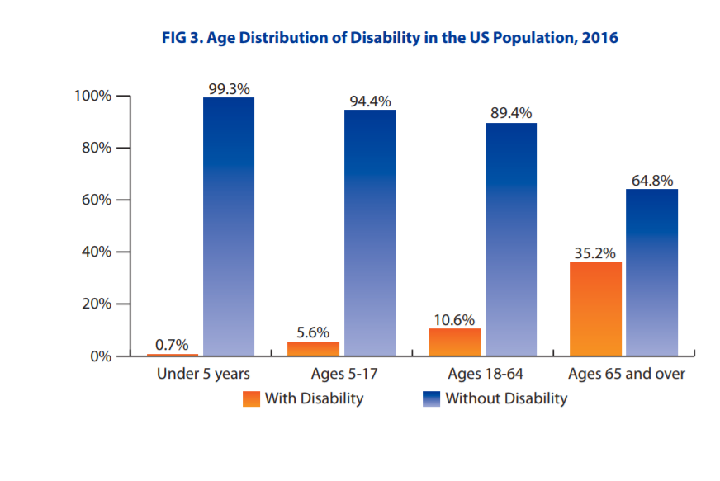
Increasingly…. The US Population is Aging
Notes:
Increasingly, the population is aging- from 46M people 65 yrs and older we are projected to have 98M by 2060-
People over 65 now represent 15% of the population- by 2060 that will increase to 24%
Older adults are generally at risk for decreased physical functioning- esp mobility- although this is not always the case-

Slide 24
Major and Converging Trends are Increasing Risk of Disasters
Global climate change
Growing urbanization
Increased population density in coastal regions
Readily spread novel pathogens
Increasing interconnectedness of complex critical infrastructure
Notes:
In addition to large and growing population of people with disabilities in the US – Another VERY Important Reason to know if OEM are ready is because of the increasing threat of disaster events nationwide and worldwide.
Climate change (heat, draught, flooding, severe winter weather, wildfires)
Climate change (heat, draught, flooding, severe winter weather, wildfires)
Increased urbanization---we now have 7.4 billion people in the world- by 2050- it will be about 11 Billion- a 40% growth- increasingly they are living in urban areas
Increased coastal populations – abt 40% (123M people) in the US live directly on a coastline- this will increase by about 10% in the next few years-
Increased globalization
Substandard public health and health care systems
Land-use that facilitates zoonotic transmission
Increased vector-borne diseases
Declining vaccination rates
Overuse of antibiotics

Slide 25
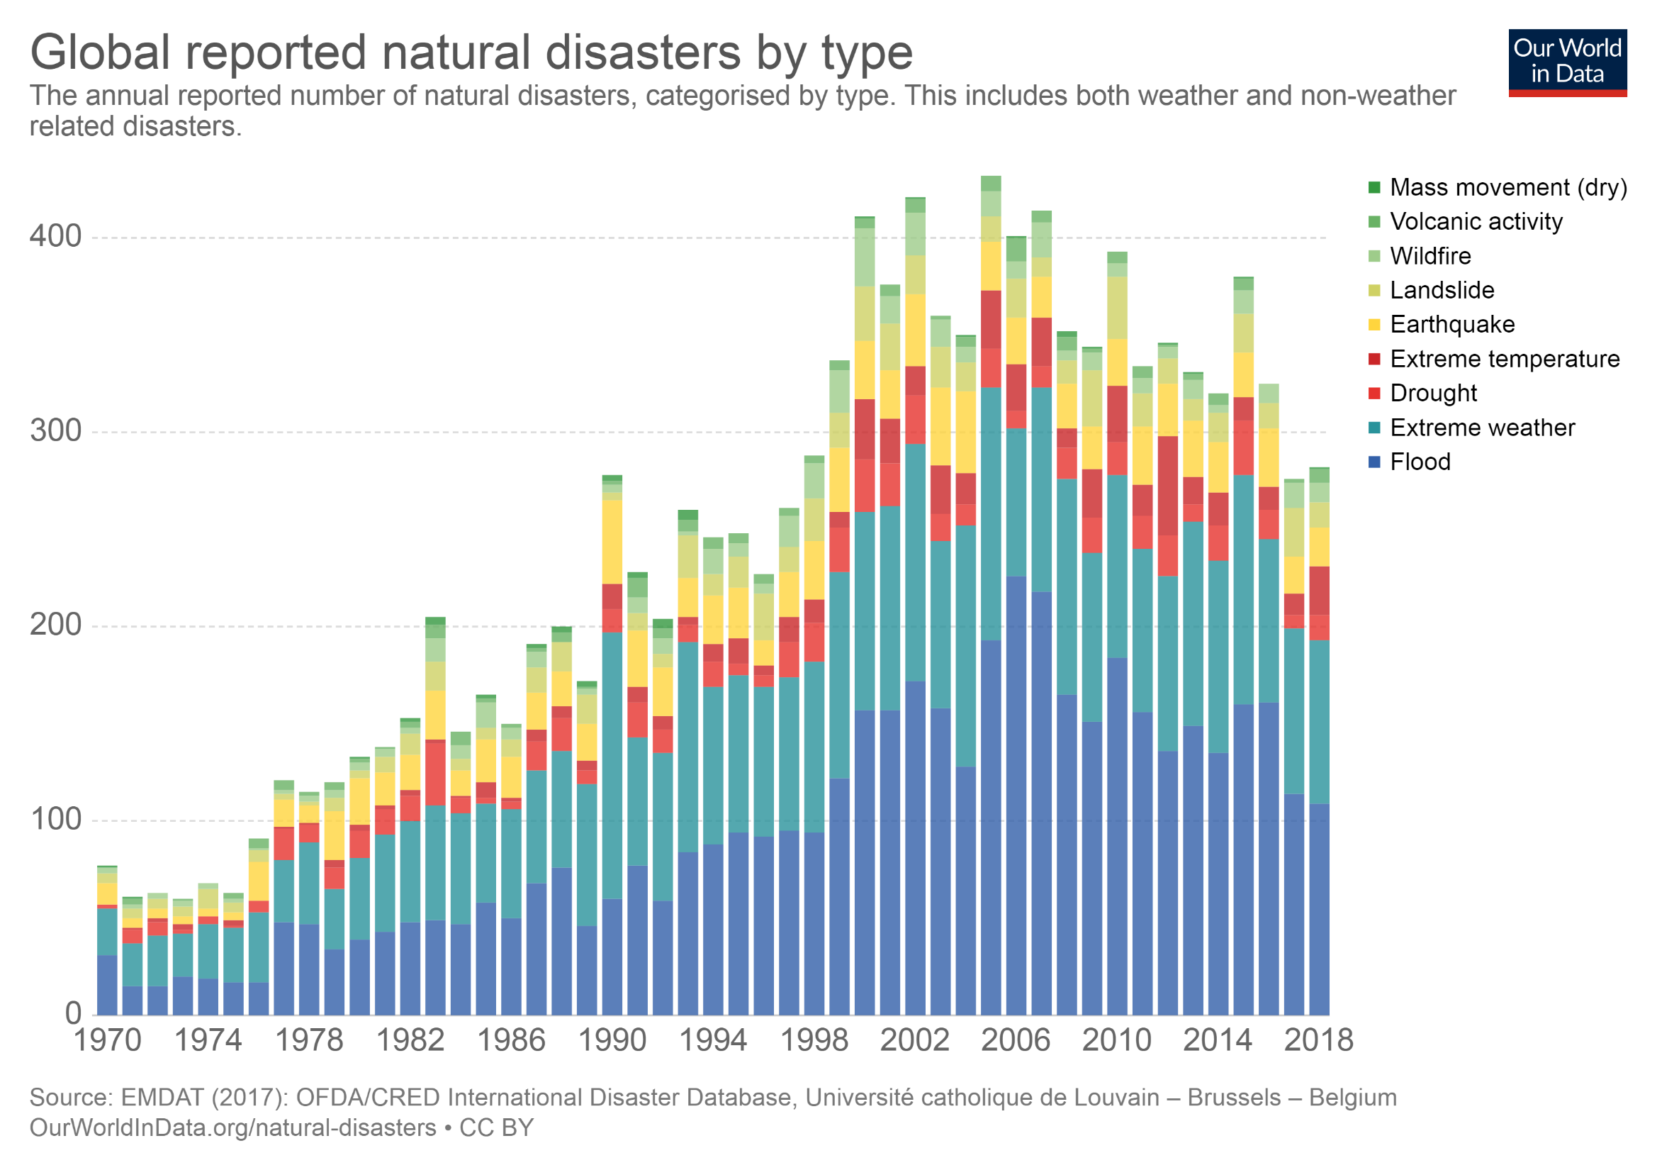
Notes:
We can see these changes in the trend maps – esp from the Center for Research on the Epidemiology of Disasters (CRED)
There are about 250-300 large scale disasters each year worldwide – we know that the increase is not due to better reporting - Starting in 1960- reporting and data collection improved dramatically.
Worldwide: The top five countries in terms of disaster occurrences are India, China, Philippines, Indonesia, and the US (US is now #2)
Slide: https://ourworldindata.org/natural-disasters
Center for Research on the Epidemiology of Disasters (CRED) : https://www.cred.be/

Slide 26

Countries with the Most Natural Disasters in 2017
# of natural disasters in 2017, by country
Note: Worldwide
Further information regarding this statistic can be found on page 8.
Source(s): CRED; ID 269652
2

Slide 27
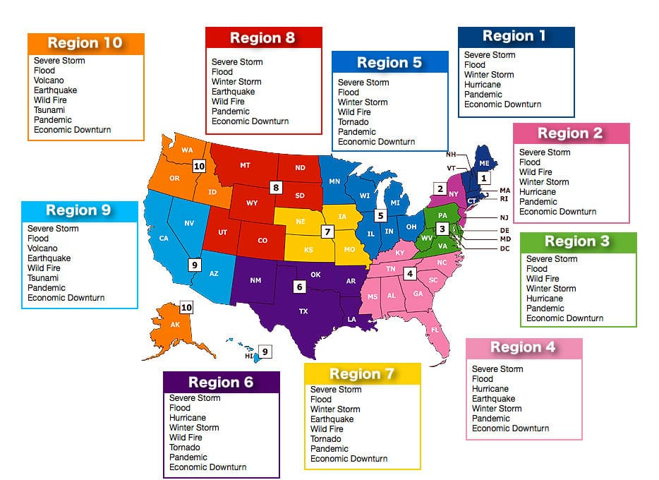
2018
US Disaster
Notes:
Disasters are highly prevalent and increasing in severity and cost in the US:
In 2017 we had 69 major Presidential Disaster declarations (federal assets and FEMA funds). These include hurricanes (including Hurricane Maria in Puerto Rico with over 3,000 deaths ), tornados, severe weather, volcanoes, earthquakes, wildfires, flooding with over 10,000 deaths and over $300B in losses. We also had 118 man-made events including 13 terrorist attacks w an estimated 3,000 deaths and $6.2B in losses.
In 2018 we had 59 major Presidential Disaster declarations, including 3 of the world’s most costliest disasters: The California Camp Fire (which started as an urban firestorm in the town of Paradise) with 86 deaths, Hurricane Michael in Florida (57 deaths) (3rd strongest hurricane in US history), and Hurricane Florence (51 deaths)(widespread flooding) in the Carolinas.
So far in April, 2019, we have had 5 major Presidential Disaster declarations

Slide 28
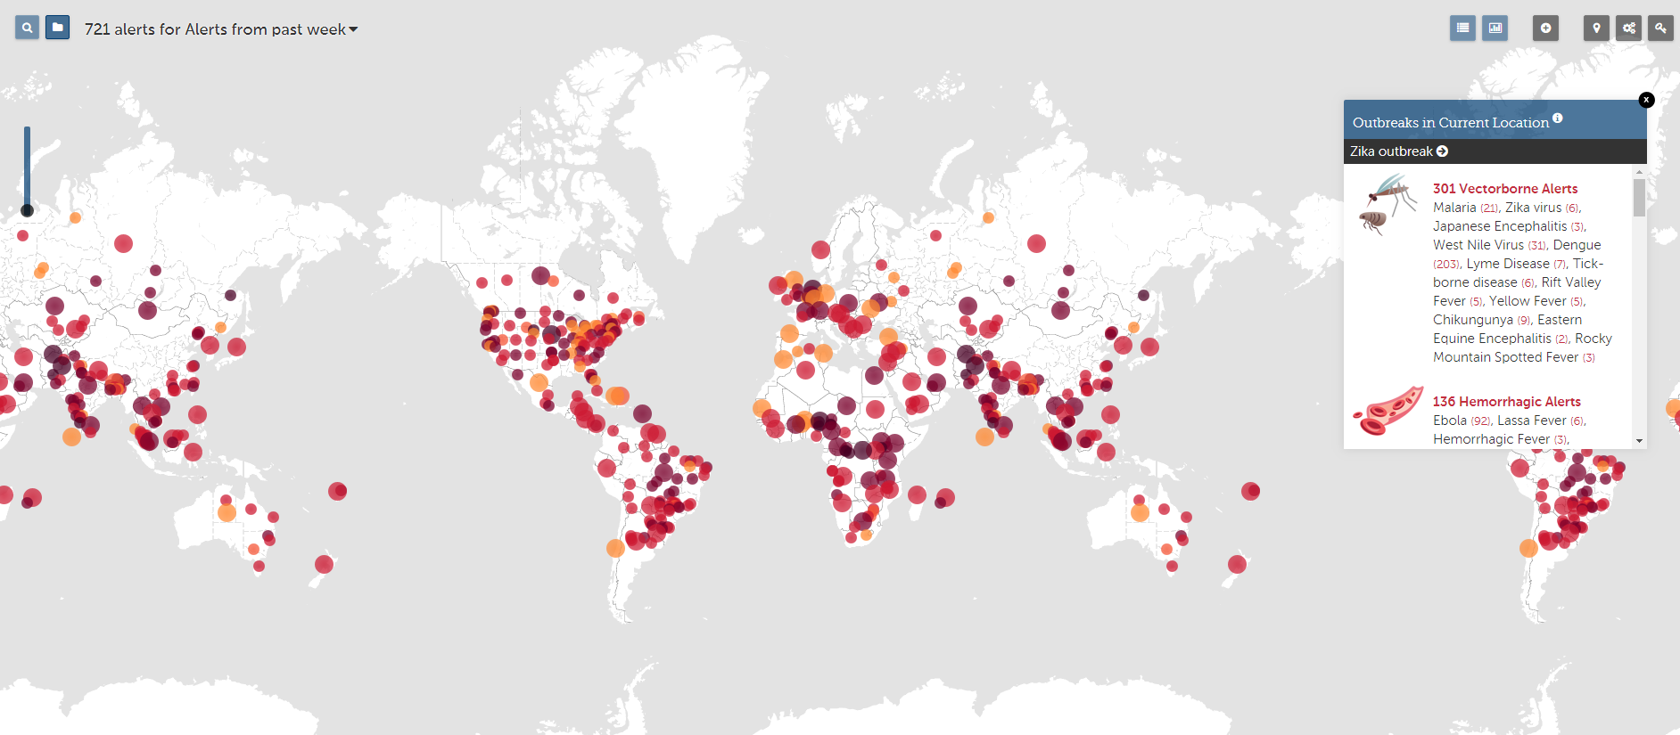
Infectious Disease Outbreaks
Notes:
https://www.healthmap.org/en/
This is a snip shot of the healthmap.org site that posts outbreaks throughout the world- it posts in real time
Here in this one week period in 2017, there were 722 outbreaks worldwide.

Slide 29
Risk factors for the Increasing Incidence of Bio-events
Human population growth
Land-use that facilitates zoonotic transmission
Increased urbanization
Increased globalization
Climate change
Increased vector-borne diseases
Substandard public health and health care systems
Declining vaccination rates
Overuse of antibiotics
31
Notes:
Growth- we now have 7.4 billion people in the world- by 2050- it will be about 11 Billion- a 40% growth. In the US we will grow from 330 M to about 400 M about a 36% increase. This population growth is leading to increased encroachment into wildlife areas
We also know that people have low levels of willingness to comply with either community or individual level public health control measures to stem outbreaks- for ex while 75% of people think quarantine of people may be needed- less than half that would be willing themselves to be quarantine. The only acceptable outbreak control measure on a list of about a dozen- was increased handwashing

Slide 30
Emerging Pathogens
HIV
Multidrug Resistant TB
(MDR-TB)
West Nile Virus
Hanta
Virus
Zika
Virus
H1NI Influenza
Middle Eastern Respiratory Syndrome (MERS)
Chikungunya Virus
Ebola
Severe Acute Respiratory Syndrome (SARS)
Notes:
In the past few decades alone, more than 85 emerging pathogens have been identified, including these listed here
We also have a threat from reemerging diseases such as measles
https://wwwnc.cdc.gov/eid/article/1/1/95-0102_article
https://www.nature.com/articles/nature02759

Slide 31
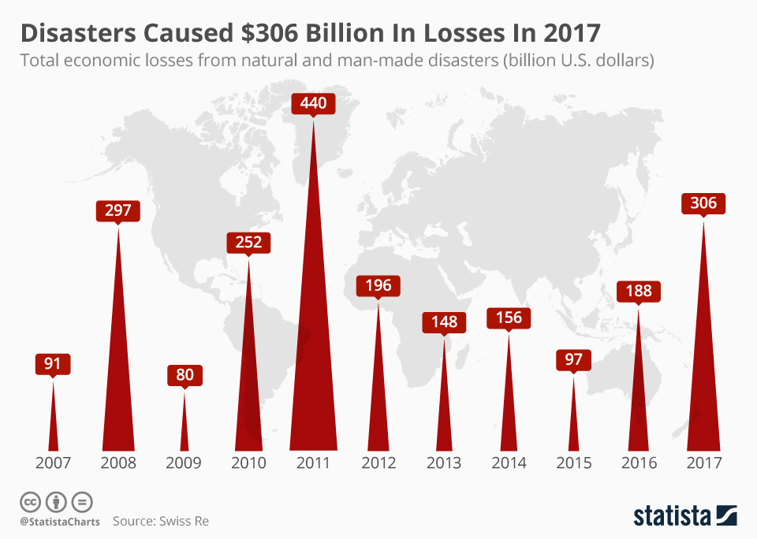
Costs Related to Disasters are Rising Too…
Notes:
Worldwide costs are great- 2011 Great East Japan earthquake, tsunami and nuclear plant meltdown
Last year in the US – we had the most expensive year of disasters ever at Over $300B due to the hurricane season and subsequent floodings and wildfires
In 2017 the US had over $300 B in losses
In 2018 we had losses of $144 B in losses

Slide 32
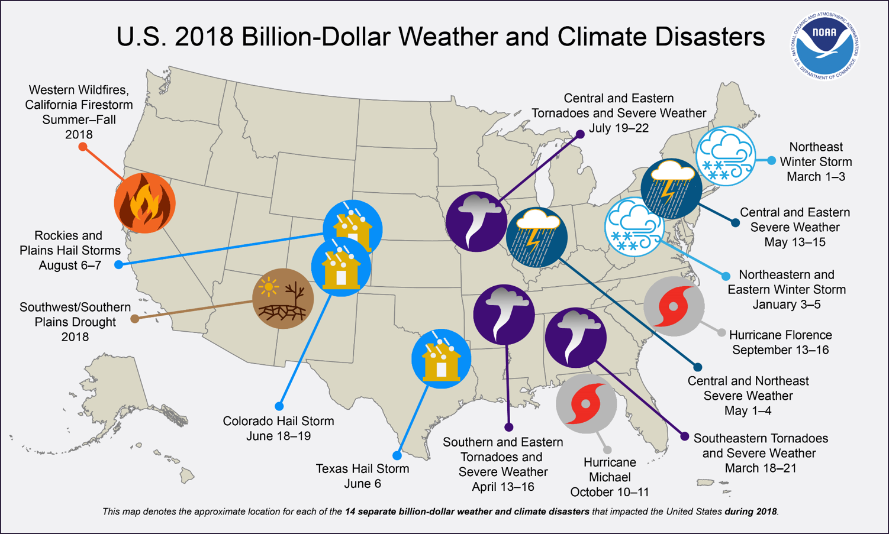
Notes:
(www.ncdc.noaa.gov/billions).
Since 1980, the U.S. has sustained 219 weather and climate disasters where the overall damage costs reached or exceeded $1 billion (including adjustments based on the Consumer Price Index, as of December 2017). The cumulative costs for these 219 events exceed $1.5 trillion.
During 2017, the U.S. experienced a historic year of weather and climate disasters. In 2017 -natural disasters in the United States cost more than $300 billion, the highest record to date- In 2017, the U.S. was impacted by 16 separate billion-dollar disaster events including: three tropical cyclones, eight severe storms, two inland floods, a crop freeze, drought and wildfires. Also, in 2017, U.S. hurricanes alone cost about $265 billion. Hurricanes Harvey, Irma and Maria now join Katrina and Sandy are now the new top 5 costliest U.S. hurricanes on record.

Slide 33
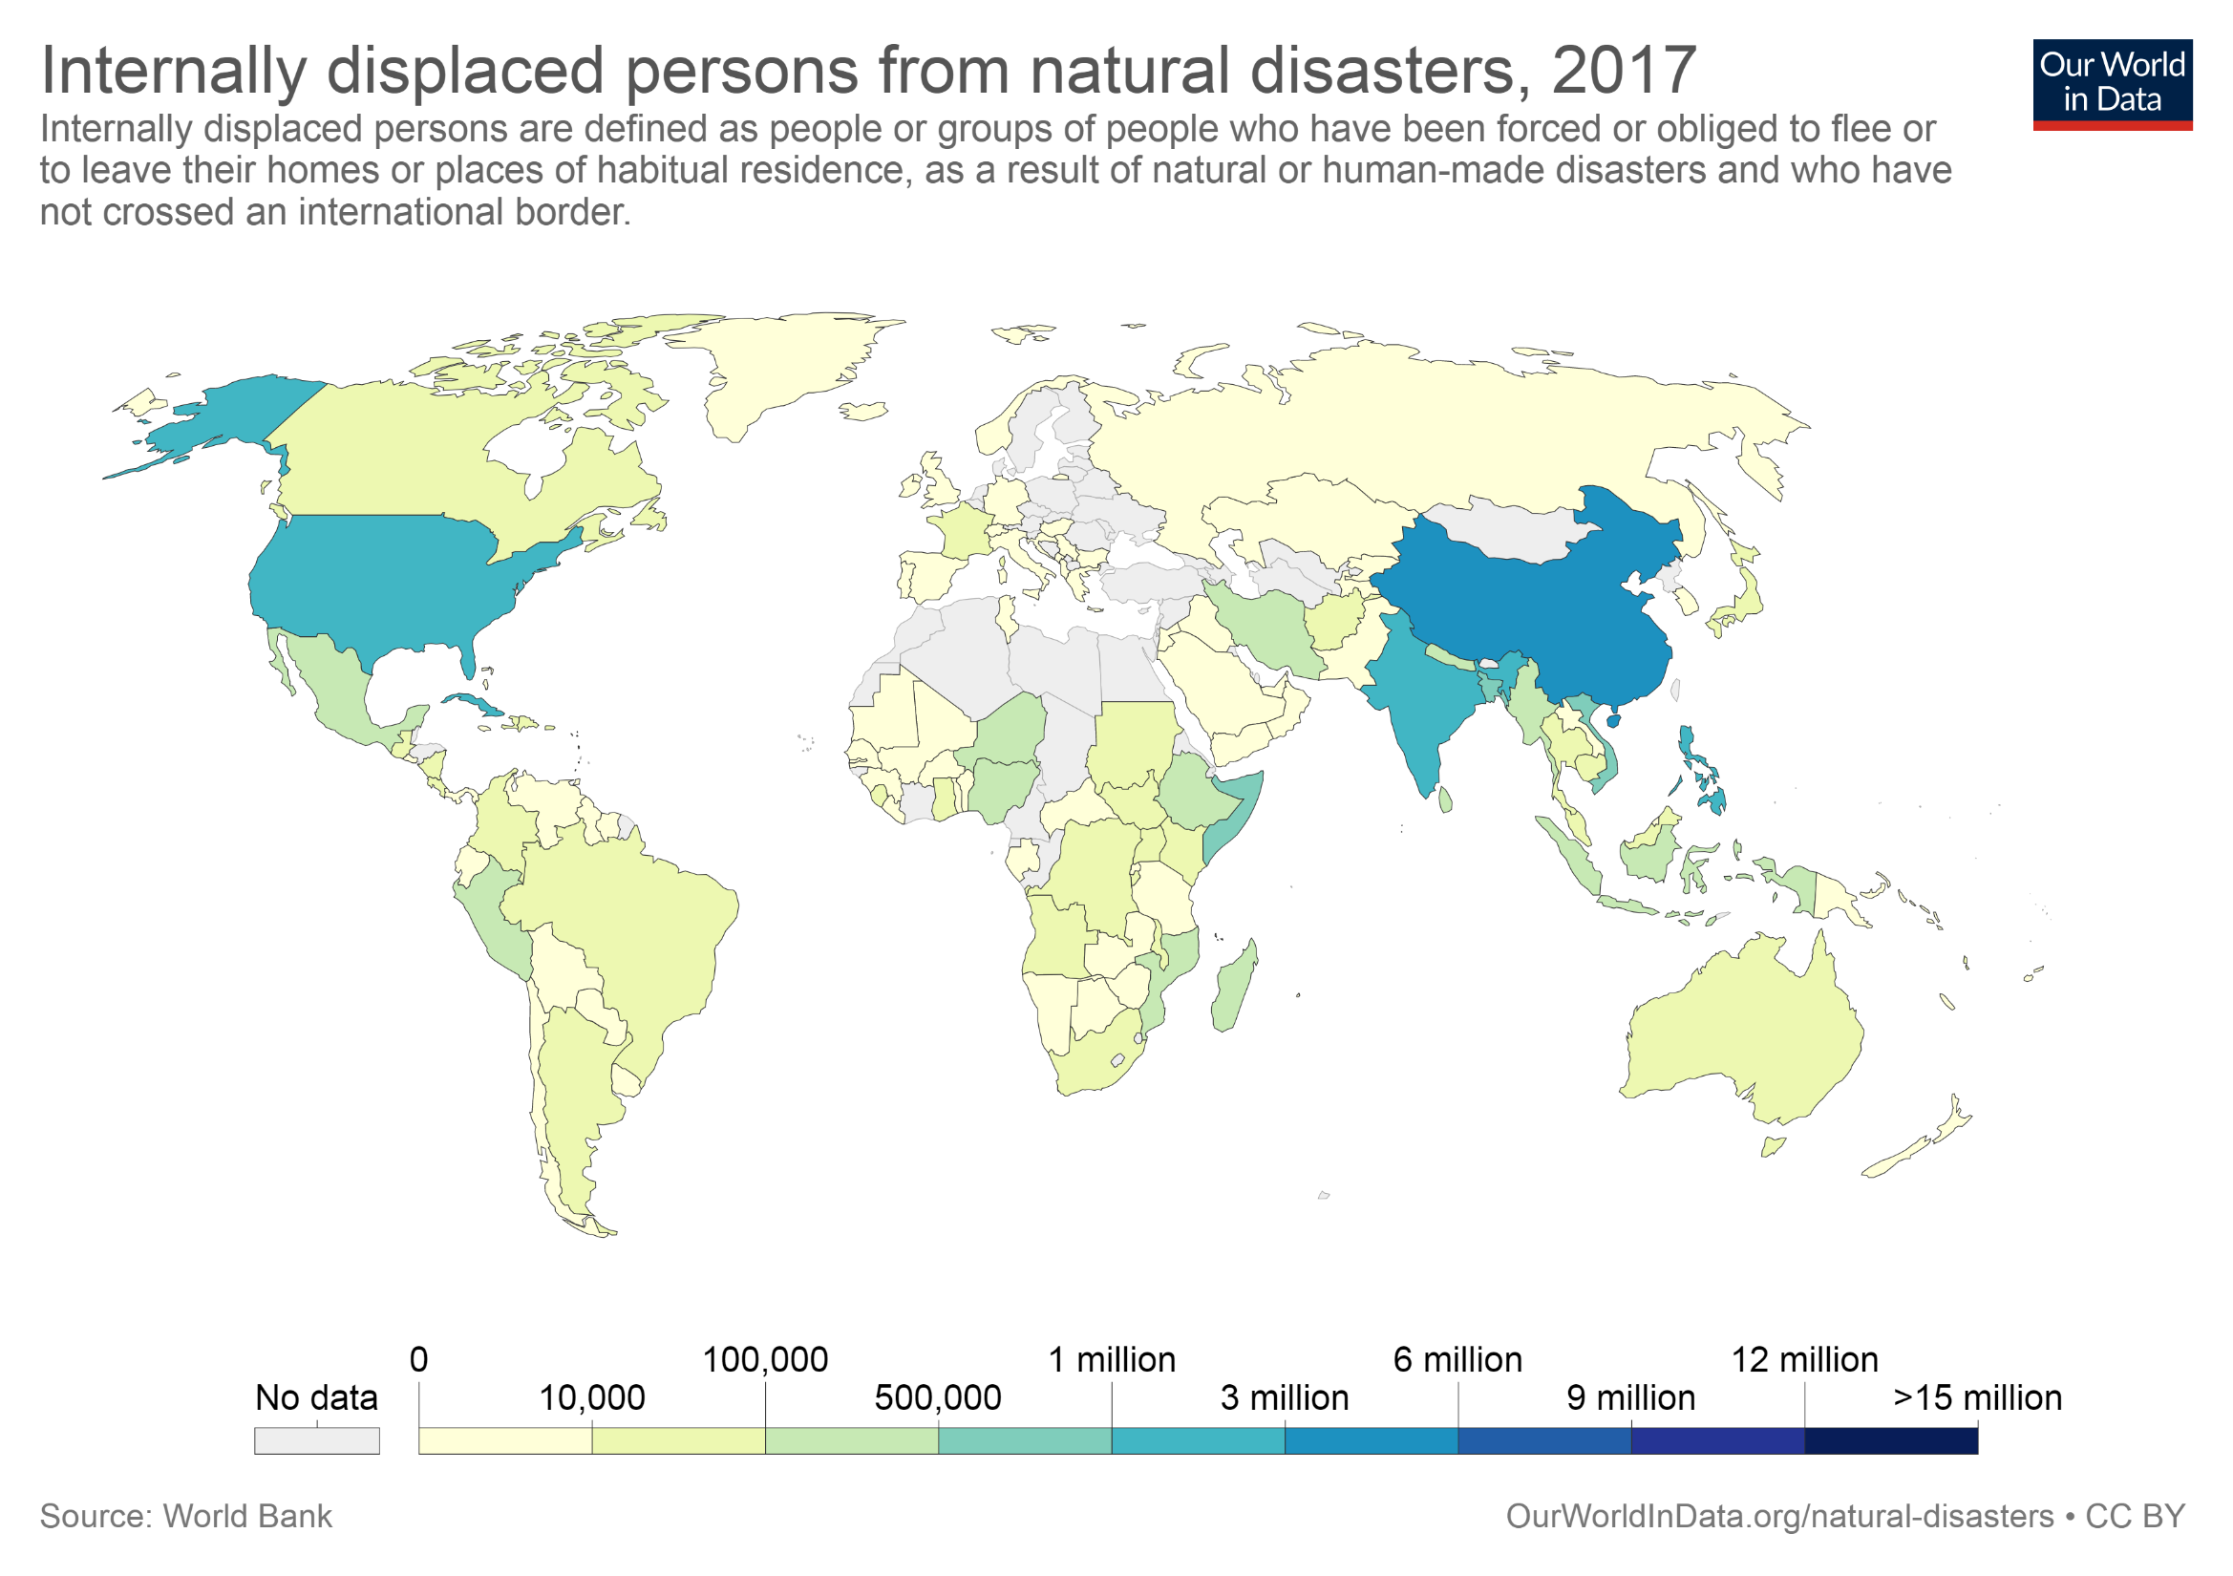
Notes:
These disaster events along w climate change are causing geopolitical unrest- resulting in mass migration of internally displaced persons – that is, they are forced to leave their homes but they have not crossed international borders.
In the US, in 2017, the three major Hurricane (Harvey, Irma, and Maria) displaced over 3 M people in the course of only one month.
This places enormous strain on our emergency management programs

Slide 34
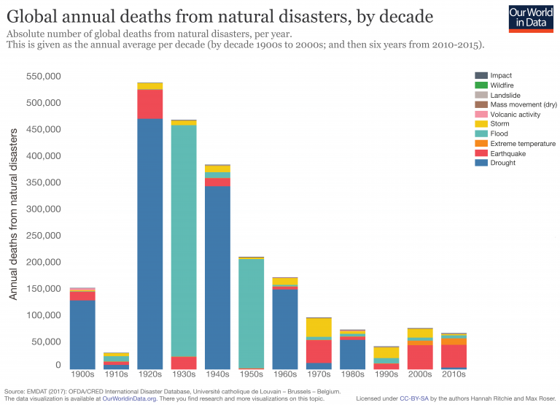
Notes:
Fortunately, though, our efforts to improve infrastructure and disaster response are leading to reductions in the number of fatalities.
Data from the Center for Research on the Epidemiology of Disasters indicate that while the number of people impacted by disasters,, and the cost is increasingly dramatically, the actual number of fatalities is declining.
https://www.cred.be/

Slide 35
Are People with Disabilities Prepared for Disasters?
2011 Gershon/Kraus Study
Convenience sample of 252 disabled people receiving personal assistance
7-item preparedness planning checklist
Notes:
So, its important to know if OEM are ready for the whole community – including people with a disability, not only because the population at risk is large, and growing, and because the number and severity of disaster events is also increasing,
But..,. Very importantly, because every indication we have indicates that people are not ready- including people living with a disability
Information on the emergency preparedness planning of people with disabilities is VERY limited
We have some data from a 2011 study conducted by Gershon and Kraus on a convenience sample of disabled people WHO also had personal assistants- we were especially interested to find out the role the PA played with respect to preparedness.
We measured preparedness using seven items: having a personal emergency plan; an evacuation plan; an easy-to-carry go bag with critical items, such as medications, cell phone, flashlight, etc.; having emergency supplies at home, such as extra food, batteries, supplies and equipment; having a communications plan for contacting the personal assistant; having an emergency contact list; and having a back-up plan for personal assistance help.
Additional items determined whether or not the respondent had tested their emergency plan, if they shared their plan with all or some of their assistants, and an open- ended question was included that asked them to provide the reasons for not sharing their plan with their personal assistant. We also asked about prior disaster experiences.

Slide 36
2011 Study- Preparedness Plan Results
47% had emergency plan
  2/3 of them had included PA in plan creation
  But 4% involved only some, 10% with none
      “My PA will be busy tending to the needs of their own family members”
      “The PA is just not that dependable”
      “I might not be with my PA when an emergency occurs.”
Notes:
Nearly half of the sample (n=120, 47%) reported that they had an emergency plan.
Of these, 66% indicated that they had involved their PA in its development, with 4.0% indicating that they shared their plan with only some of their Pas, 10% had NOT shared the plan with their PAs. Common reasons given for not sharing their plan with PAs included: “My PA will be busy tending to the needs of their own family members, “The PA is just not that dependable”, “Experience tells me I can’t count of them”, “I have a new PA and they did not help me develop the plan”, and “I might not be with my PA when an emergency occurs.” Of those reporting a plan, 57.5% (n=69) reported that they had actually tested their ability to use the plan. Involvement of the PAs in the emergency plan was strongly associated with emergency preparedness; but sample size was small and results should be interpreted with caution.

Slide 37
  2011 Study- Emergency Preparedness Checklist Results
  7- item scale, mean score was 2.3 (range, 0-7)
  47% had emergency plan
  35% had an evacuation plan
  35% had emergency contact list
  32% had emergency supplies available at home
  29% could communicate with PA in emergency
  28% had go-bag ready
  26% had back-up PA plans
Notes:
SCORE would be 33%
35% had an evacuation plan, 28% had a go-bag ready, 32% had emergency supplies available, 29% had a way to communicate with their PA in case of an emergency; they planned to communicate using cellphones (28%), text messages (13%), emails (146%), online social networks (3%), two-way radio (0.8%) and ham radio (0.4%). In terms of having an emergency contacts list, 35% had such a list.
With regards to the planning for an alternative source of personal assistance in case their regular PA would not be available to assist them during an emergency, 26% reported that they had made alternative back-up plans. For those participants indicating an alternative back-up plan, 77% would rely on family members, 51% would rely on friends, 36% would rely on neighbors, 1% on co-workers. A very small proportion, 4% reported that they intended to hire another PA “on the spot.” A low proportion, 20% thought that the agency providing for their care would allow their PA to accompany them in order to continue to provide services if they were evacuated to another area (such as a shelter or a hotel).
On the 7-item emergency preparedness scale, the mean score was 2.3 (S.D.=2.74), the median was 0.0, the mode was 0.0, and the range was 0-7. The Cronbach alpha was .93 (95% CI .916- 942), indicating a good internal consistency for this scale.

Slide 38
2011 Study- Conclusions
  Higher EP Scores:
    Having a plan and engaging PA in the plan
    Past disaster experience was significantly associated with higher emergency preparedness
  Lower EP Scores:
  Lack of sharing the plan with all of PAs
  Lack of planning for back-up when no PA
  Distrust in PAs reliability seems to be a barrier to sharing the plan
  Lack of emergency contacts list or back-up sources of necessary supplies and medications
Notes:
NOTE Positives, negatives, and questions. Having a plan, and engaging the personal assistant in the plan was clearly associated with higher emergency preparedness scores. However, serious deficiencies in emergency preparedness remained, even for those who had involved their PAs in their planning effort. Of particular note was the lack of sharing the plan with all of their PAs , for those with multiple PAs. Also of concern was the absence of planning for back-up assistance in the event that the PA was unavailable to provide help. For the proportion reporting that they were without personal assistance from any source during an actual emergency, it is not known to what extent their assistance needs were adequately met and what impact this had on their health and well being. Identifying back-up care providers and sharing the plans with all PAs are critical preparedness strategies for people with disabilities. For some participants, distrust in the PA’s reliability seems to be a barrier to sharing the plan, and this requires further investigation to understand the roots of this lack of trust. There was also evidence of a lack of preparedness on other basic elements of a plan, such as having an emergency contacts list or back-up sources of necessary supplies and medications.
More than half of the participants reported that their PA was not with them during the emergency, and having a communication plan in place might have helped them to reach their PA. Multiple sources of communication should be considered in case land lines are not in operation, or if cell phone towers are inoperable or overloaded.

Slide 39
2014 Study on Disaster Preparedness of Elderly Home Care Recipients in San Francisco, N=50
Mean score of 4.74 on a 13- item preparedness checklist
56% had extra meds on hand
44% had back-up power for powered equipment they use
38% had made back-up plans for their caregiver(s)
26% had plans for transportation to shelters
19% had someone in building that could help them evacuate if elevator not working
70% had extra supplies on hand for their pets
Notes:
We know from a more recent study I conducted that vulnerable elderly people (who are also often disabled) are NOT ready
and importantly, the size of the elderly population is growing- while people 65 and over represent 15% of today’s population, by 2060 they will represent about 25% of total population.
This was a qualitative theory generating study of the factors that influence preparedness in elderly-
Data were collected using a semi-structured interview from 50 elderly home care patients- all receiving home care

Slide 40
Barriers To Personal Preparedness
Lack of self-efficacy (Lack of resources, No family or friends nearby)
  “ I can’t do those preparedness things; the government should help me.”
Risk awareness was high, but relevance of risk to them was low:
“I’ve lived a full life, actually, I’m ready to go…”
Sense of community was low
“They don’t really care. I’ve been sick right in here, and no one came and knocked on the door…that’s just the way it is.”
Lack of Trust in Authorities
“There’s going to be a big mess-up between the police and firemen”
“ You can’t depend on the police, fire, the army, or national guard. You can’t depend on the city or county.”
Notes:
Self- efficacy was low - many felt they could not do much to help themselves
80% had household incomes of 20K or less. No material or social support resources in many cases
Wanted govt, first responders, clergy, strangers, anyone to help them
Risk awareness was high but fatalism led to lack of preparedness

Slide 41
2014 FEMA Report
“Preparedness in America”
21% of the US sample (N=2,000) WERE NOT planning to do any disaster preparation.
46% - Preparedness was not at all on “their radar.”
Cost and not knowing how to prepare were barriers.
However, people who thought they were at risk, thought they could do something to prepare, thought preparing would help them, and felt confident in their ability to prepare WERE MORE LIKELY to be prepared.
Notes:
Finally we have information on the general population and how well they are prepared from FEMA National Preparedness Surveys
2014 FEMA National Preparedness Survey – that people in general are not ready
**Denial is a maladaptive response to fear
FEMA report: https://www.fema.gov/media-library-data/1409688068371-d71247cabc52a55de78305a4462d0e1a/2014_NPR_FINAL_082914_508v11.pdf

Slide 42
2014 FEMA Study - Results
   Only small differences were noted for participants with and without a disability.

Slide 43
To Recap-Why is it important to know if OEMs are ready or not?
Population at risk is large and growing
Disasters are increasing in frequency and severity
Individual-level preparedness is low
And……

Slide 44
People with Disabilities are Disproportionately Affected by Disaster Events
Latest US data suggest a 30-50% increased risk of disaster-related fatality among people with disabilities.
  1/3 of Hurricane Maria fatalities are believed to have resulted from “interrupted care”
Other vulnerable populations in addition to those with disabilities also disadvantaged:
  Children, pregnant women, seniors, those with limited English proficiency, transportation disadvantaged, and institutionalized individuals.
Notes:
FINALLY --we need to know if OEM are prepared to ensure access and meet the needs of people living with a disability- because they are at increased risk of morbidity and mortality
Also, meeting their responsibilities can help reduce the threat of lawsuits
UNISDR 2013 Survey on Living with Disabilities and Disasters
Perhaps the most significant finding in the survey is that 85.57% of the respondents from 137 countries state that they have not participated in community disaster management and risk reduction processes currently in place in their communities.
In effect, they have been excluded from the decision making and planning of such processes.
72.20% of respondents say that they do not have a personal preparedness plan in the event of a disaster.
Of the 29.29% of people with disabilities who do have a personal disaster preparedness plan, the most important stated element of that plan is support from family.
Another key finding reveals that only 20.6% of respondents believe they can evacuate immediately without difficulty in the event of a sudden disaster event. And while 38.1 % can do so with some difficulty, 34.93 % of respondents believe they will experience a lot of difficulties; 6.3 % state that they will not be able to evacuate at all. If given sufficient time, the percentage of those who can evacuate with no difficulty rises from 20.65 to 38.22% but 57.71% still feel they will have either some, or a lot of, difficulty; 4% would still not be able to evacuate.
The top six hazards or disaster risks faced by survey respondents were: floods (56.67%); extreme weather (42.58%); drought (39.52 %); tornados (38.31%); earthquakes (32.52%) and cyclones (30.64%).

Slide 45
Underlying Questions
What are the roles and responsibilities of OEM … with respect to ADA?
Why is it important to know if OEMs are ready or not?
What types of information can help us answer this question ?
How can information on OEM readiness be helpful?
Notes:
We need data to find out if OEMs are ready to ensure access and meet the needs of people with disabilities

Slide 46
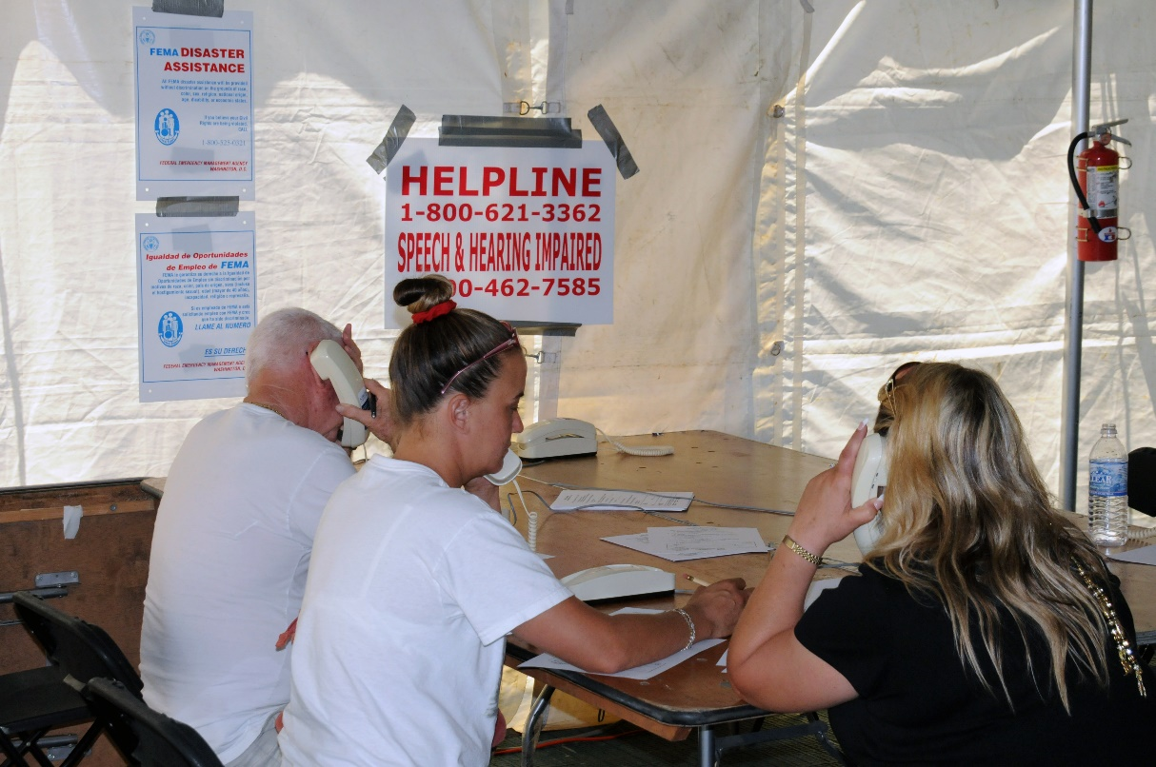

ADA Implementation Among OEM
FEMA Region 9
 To determine the extent to which ADA requirements have been implemented by local OEM
Notes:
RC

Slide 47
Study Methods
Study conducted in winter, 2018
Input from key stakeholders
Confidential web-based survey of local Offices of Emergency Management (OEM) in FEMA Region 9, (California, Nevada, Arizona, Hawaii, and the Pacific Islands).
Respondents (N=75) – Multi-modal recruitment
Questions on inclusiveness at key disaster phases: mitigation, planning, response, and recovery.
Notes:
Marci Roth
Erica Jones
June Kailes
Heavy focus on items from the ADA checklist and other available materials
The sample frame for this group (OEM) is not well delineated

Slide 48
Study Methods
Survey was pilot tested
Final survey had 40 items and took about 15-20mins to complete
Statistical analyses were primarily descriptive, graphical, and factor analysis of the scale
Notes:
Most items used yes/no response categories
An indirect structural projective approach was taken to avoid socially desirable response bias
OEM characteristics, including prior disaster experience
OEM planning for people with disabilities (evacuation, transportation, sheltering, communication)
Written plans- including Operating procedures
Engagement activities
Training of staff and volunteers
Exercises and drills
Engagement with businesses, including high rises where people with disabilities work
Recovery activities, including access to benefits

Slide 49
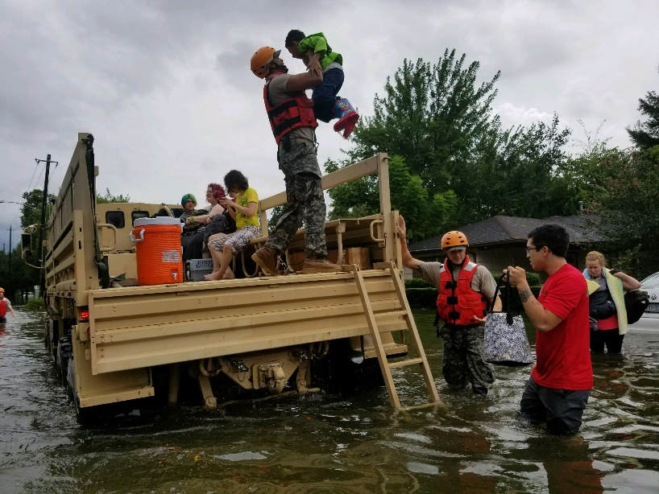
2018 - Study Results
 Most respondents served a population of 100-500K
 Small staff- typically just themselves, or 2-5 staff
 About half reported at least one major disaster event in their jurisdiction in the last 5 years.
Notes:
More than half of the sample came from California, followed by Arizona, Nevada, Pacific Islands, and Hawaii
13% reported jurisdictional size of 1,000-25,000
30% only the Director, 35% 2-5 people
Only 6% had more than 25 staff
16% reported that one or more of their staff had a disability

Slide 50
2018 - Study Results
35% have access to estimates of the number of people with disabilities in their jurisdiction
  Further, only 1/3 of those with estimates had used them in their planning
55% maintained up-to-date lists of local disability agencies and caregiver groups
Notes:
If they had the estimates- they used this information to a great degree when planning for shelter needs- emergency power, accessible communications, medications, medical supplies,
They also use this info to have plan for accessible transportation
And for accessible transportation
RC

Slide 51
2018 - Study Results
Three-quarters prepare plans that address people with disabilities
52% had an ADA Coordinator in their jurisdiction
About 50% involve the ADA coordinator in plan preparation
Roughly 54% involve disability organizations
52% have detailed Operating Procedures in the plan
Notes:
In half the cases, planning info on the needs of people with disabilities is in the main documents, one quarter said it was in an annex.
About 50% had Operating Procedures that addressed accessibility in their plan

Slide 52
2018 - Study Results
Training
  69% train all staff/volunteers on the Plan
  41% train all staff/volunteers on identifying the needs of people with disabilities
  49% train all staff/volunteers on meeting the needs of people with disabilities
  39% train all staff/volunteers on the requirements under ADA
Roles
78% stated that OEM managers are clear about their role and responsibilities for providing equal access to services for people with disabilities
  Only 36% said that they have qualified staff and other resources needed to fulfill their responsibilities under the ADA

Slide 53
2018 - Study Results
Communications
Types of emergency notifications for people with disabilities
  82% Closed captioning
  82% Social media
  80% Reverse 911
  68% Verbal description of evacuation zones, road closures
  68% American Sign Language interpreters at press conferences

Slide 54
2018 - Study Results
Tested emergency warnings with people who had disabilities
Tested with people with…..
  28% vision disabilities
  33% hearing disabilities
  25% mobility disabilities
  13% cognitive disabilities
  9% mental health disabilities
Notes:
Only 31% reminded local TV stations to have sign language interpreters when providing any emergency information

Slide 55
2018 - Study Results
MOUs for providing necessary services
  89% shelter facility operations
  53% accessible transportation
  53% registration desk staff had customer service training for people with disabilities
  52% sign language interpreters at shelter
Notes:
f

Slide 56
2018 - Study Results
Training of local first responders
To their knowledge…
Local first responders typically receive training on….
52% the disaster needs of people with disabilities
40% requirements under ADA
Notes:
RC

Slide 57
2018 - Study Results
Accessible features of Mass Care Shelters, Disaster Assistance Shelters, and other emergency shelters
86% Ramps
76% No barriers to wheelchairs
70% Used ADA Checklist of Existing Facilities for restroom accessibility
67% Emergency generator
58% Quiet rooms available
50% Immediate access to food and refrigerated meds
42% Oxygen availability
35% Alternative formats of communication
Notes:
Alternate formats: braille, large print, audio tape

Slide 58
2018 - Study Results
Service Animals
84% Policy modifications to allow
71% Relief areas

Slide 59
2018 - Study Results
Personal Assistants
67% Policies to allow PA to visit and do tasks
Medical Shelter Diversion
25% Tend to shelter people with disabilities in medical shelters – even if they DO NOT have a medical condition that requires it

Slide 60
2018 - Study Results
Monitoring of staff and volunteers to ensure they provide safe, appropriate assistance with ADLS and wheelchair transfers, if needed?
60% - Yes, they are trained and monitored to assure they provide such assistance
Notes:
ADLs- Activities of Daily Living

Slide 61
2018 - Study Results
Coordination with local employers
24% Coordinate with local employers
Coordination with high-rise building managers
29% Coordinate with high-rise building managers
Notes:
For assisting employees, visitors, customers who may need assistance in evacuation

Slide 62
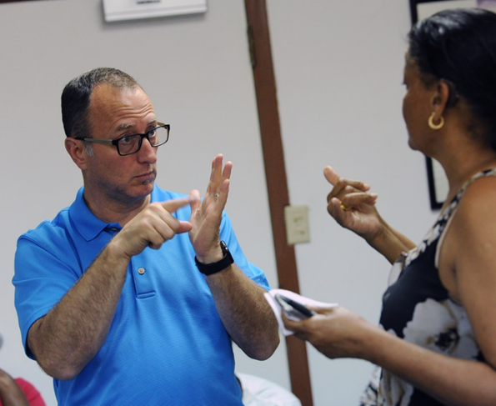
2018 - Study Results
45% actively involve people with disabilities in drills/exercise
Accommodations made to engage people with disabilities in drills
28% Accessible transportation
21% Sign language interpreters

Slide 63
2018 - Study Results
Recovery
70% Assist people with disabilities in obtaining information
79% Provide appropriate equipment (computers, phone chargers, etc.,) to gain access to this info
After-Action Reports and Mitigation Planning
93% of OEM said these are typically prepared, 90% said changes are made
48% Involve people with disabilities in their preparation
39% Involve people with disabilities in post-disaster mitigation planning

Slide 64
Measure of OEM Preparedness
11 items from the survey were highly correlated
Average score was 4.9, max=11 (50% grade)
Involve disability organizations or people with disabilities in Plan preparation
Involve local ADA Coordinators in Plan preparation
Plan has detailed Operating Procedures for ADA
Considers needs of people with disabilities in evacuation planning
Pre-identified accessible transportation
Pre-identified accessible shelters
Notes:
This score ranged from 0-11
The mean was 4.91, the mode 5.0, the range 2-11.
The score was less than 50% overall.

Slide 65
Measure of OEM Preparedness
11 items from the survey were highly correlated
7. Shelter staff/volunteers trained and monitored
8. Consider needs of people with disabilities who may have to shelter-in place at work
9. Accessibility is considered for engaging people with disabilities in drills
10. Ensure proper equipment available to ensure access to benefit info
11. Work with ADA coordinator on Emergency Preparedness for people with disabilities

Slide 66
Significant Correlations with Preparedness
High score correlates
Collaboration with disability coordinators and other partners
Managers have clear roles and responsibilities
Qualified Staff
Engagement of people with disabilities

Slide 67
What Do Local OEM Need for ADA Improvement?
61% More training on ADA requirements
61% Better community outreach to people with disabilities
59% More drills involving people with disabilities
59% Better communications systems for people with disabilities
57% More planning with local partners and volunteer orgs
56% More back-up power
53% More accessible transportation

Slide 68
How They Want to Receive Training
Training: 79% Two-week Emergency Mgt Institute
43% Webinars
43% On-line courses
Trainers: 67% First responders
65% Non-govt agencies (e.g., Red Cross, Disability orgs)
64% Health Dept
56% Utilities
54% Hospitals/healthcare Orgs.

Slide 69
Conclusions
Suboptimal preparedness of OEM was noted
Engagement of Disability Coordinators and people with disabilities was beneficial
Clearly there is interest in improvements- especially around more info on ADA
Notes:
Study limitation: Small convenience sample, only one FEMA region, socially desirable responses
People who responded may have been the MOST likely to be prepared

Slide 70
Underlying Questions
What are the roles and responsibilities of OEM … with respect to ADA?
Why is it important to know if OEMs are ready or not?
What types of information can help us answer this question?
How can information on OEM readiness be helpful?
Notes:
We need data to find out if OEMs are ready to ensure access and meet the needs of people with disabilities

Slide 71
Future Directions
Disability expertise is needed at ALL levels of disaster preparedness and response
National focus is needed- if response is pushed back onto states- there may be uneven or disparate response for people living with disabilities
What do these findings suggest to the webinar participants??
Notes:
This information reinforces and underscores the fact that we need disability expertise at all levels of disaster

Slide 72

Thank you!!
Robyn Gershon
rg184@nyu.edu
Lewis Kraus
lewisk@adapacific.org

Slide 73

Resources
Pacific ADA Center
 www.adapacific.org/emergency
 Webinars - ADA National Network/FEMA Webinar Series: Emergency Management and Preparedness-Inclusion of Persons with Disabilities (www.adapresentations.org)
Notes:
LK

Slide 74
Resources
Pacific ADA Center
 www.adapacific.org/emergency
 Checklists and toolkits (Personal)
  Bedside Emergency Supplies Checklist
  Car Emergency Supplies Kit Checklist
  Carry On You Emergency Supplies Kit Checklist
  Emergency Contact List
  Emergency Food and Water
  Emergency Power Planning
  Emergency Supplies Kits
  Keep Your Important Documents Safe from a Disaster
Notes:
LK

Slide 75
Resources
Pacific ADA Center
 www.adapacific.org/emergency
 Checklists and toolkits (Personal)
  Evacuation Transportation Planning Tips
  Grab and Go Emergency Supplies Kit Checklist
  Grab and Go Emergency Supplies Kit with Daily Use Items Checklist
  Home Emergency Supplies Kit Checklist
 Checklists and toolkits (Agencies)
  Maintaining Site Accessibility Checklist
  Press Conference Checklist
Notes:
LK

Slide 76
Bibliography
 FEMA Guidance for Functional Needs Support Services
https://www.fema.gov/media-library-data/20130726-1831-250457316/fnss_guidance.pdf
 ADA Web Courses
https://www.adapacific.org/training-ada-basic-web-course
 Annual Disability Statistics Compendium
https://disabilitycompendium.org/
 “Emergency Preparedness in a Sample of Persons with Disabilities” by Gershon et al.
https://www.ncbi.nlm.nih.gov/pubmed/23716372
Notes:
LK

